Slide 1
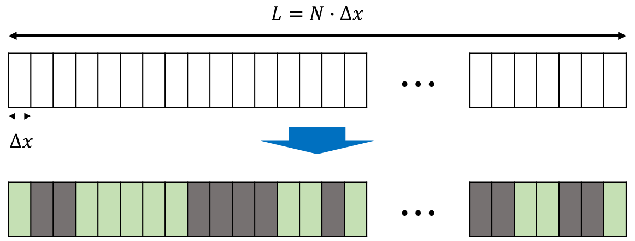
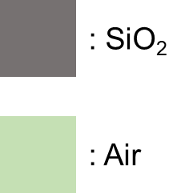

DBR Design Platform
Design wavelength: 300 μm (1 THz)
Wavelength: 150 – 3000 μm (0.1 – 2 THz)
5 um step, 570 points
TE mode
$N=80$, $∆x=5$ μm
1 for SiO₂
$n_{{SiO}_{2}}=2.092$ @ 1 THz
0 for Air
$n_{Air}=1$ @ 1 THz

Slide 2
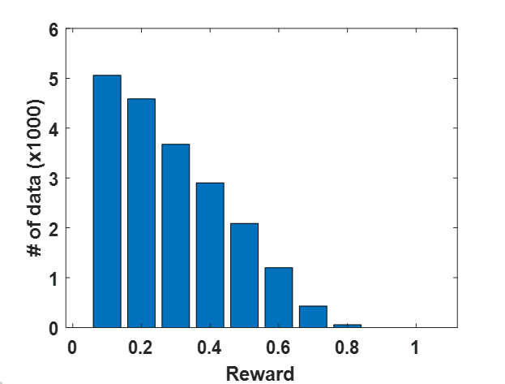
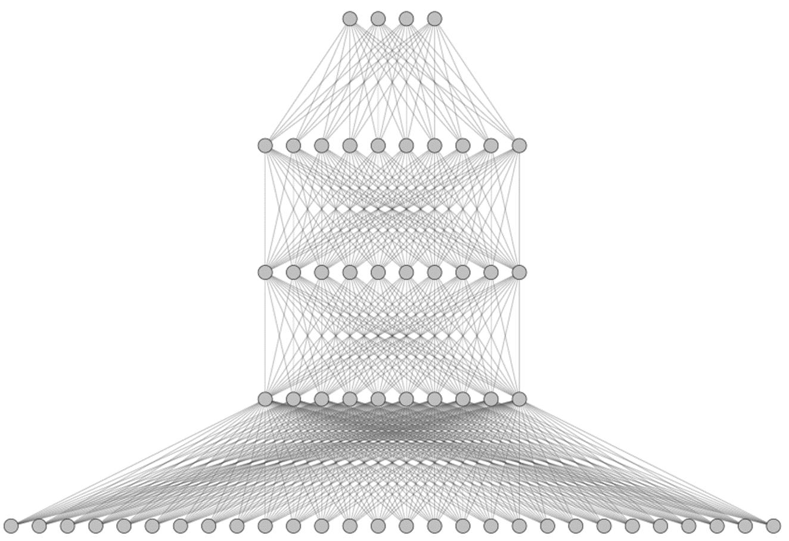


DBR Design Platform
Train data distribution:
ANN structure
Randomly generate 20,000 data
Input : 80 node
Output: 570 node
Model: FCDNN
Hidden layer: 200 node, 3 layer
$$C≡mean\left(R_{out}\right)∙\left(1−mean\left(R_{in}\right)\right)$$
$$Loss=mean\left\{{\left(\hat{y}−y\right)}^{2}\right\}$$

Slide 3
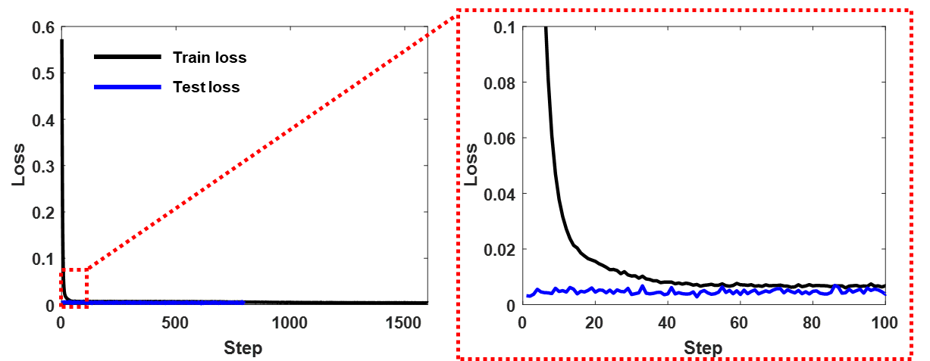
DBR Prediction ANN

Slide 4
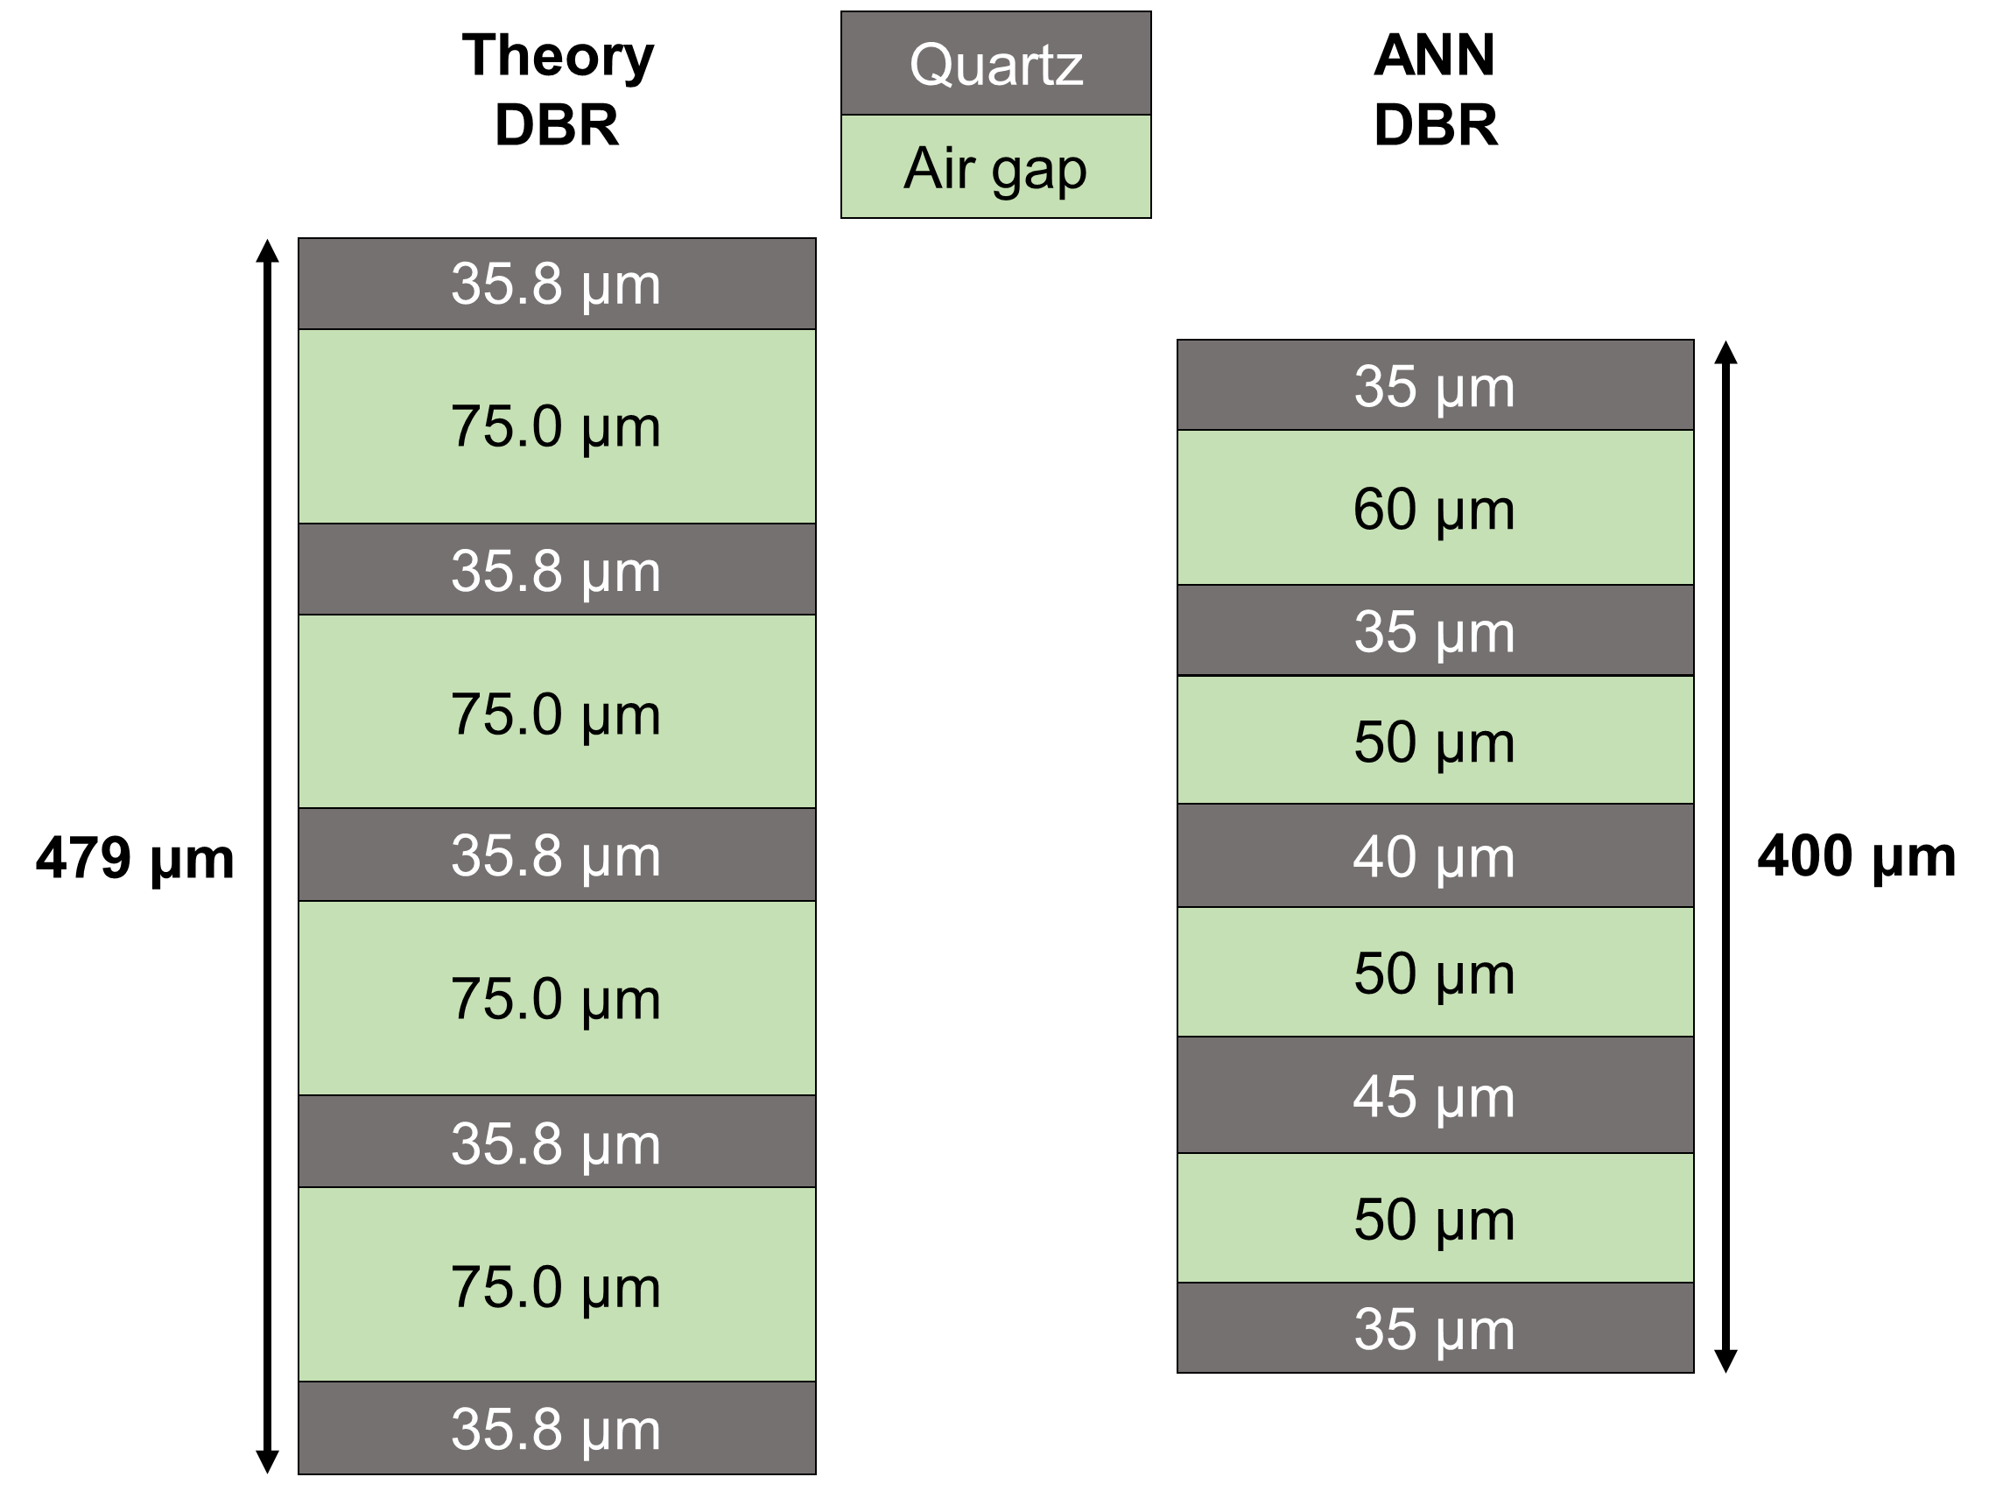
Reflectance of DBR
ANN
Theory
 | Maximum Reflectance | FWHM | 99% bandwidth
ARL | 0.9962 at 1.11 THz (270 μm) | 0.584 THz (155 μm) | 0.339 THz (85 μm)
Theory | 0.9978 at 0.99 THz (300 μm) | 0.553 THz (180 μm) | 0.354 THz (110 μm)

Slide 5
(a)
(b)
ANN
Theory

